Slide 1


Text editor using java
Prepared by:-
Name: Tirth Rakesh Patel
Enroll no: 21002170310038
Roll no: 230
Batch: D1
Branch: CSD

Slide 2
Introduction:
It can be used to create simple documents. The most common use for Notepad is to view or edit text (.txt) files.
Apache Netbeans is been used because it provides a good graphical interface.
The main objective of this project is to edit or update the text as you want. It acts like as windows notepad so having all of the function of it. Thus it makes a very important role in the Text Editing.

Slide 3
Basic features:
The Notepad application is a menu driven application that performs text editing operations: File, Edit and Search.
File operations include new, open, save, save as and exit.
Edit operations has undo, redo, cut, copy and paste.
Search option allows user to find a text they are looking for in the file.

Slide 4
Libraries Used:
Java AWT: Java AWT (Abstract Window Toolkit) is an API to develop GUI or windows-based applications in Java. Java AWT components are platform-dependent i.e. components are displayed according to the view of operating system.
Java IO: Java IO or Input Output in Java with input stream, output stream, reader and writer class. The java.io package provides api to reading and writing data.
Java SWING: The javax.swing package provides classes for java swing API such as JButton, JTextField, JTextArea, JRadioButton, JCheckbox, JMenu, JColorChooser etc.

Slide 5
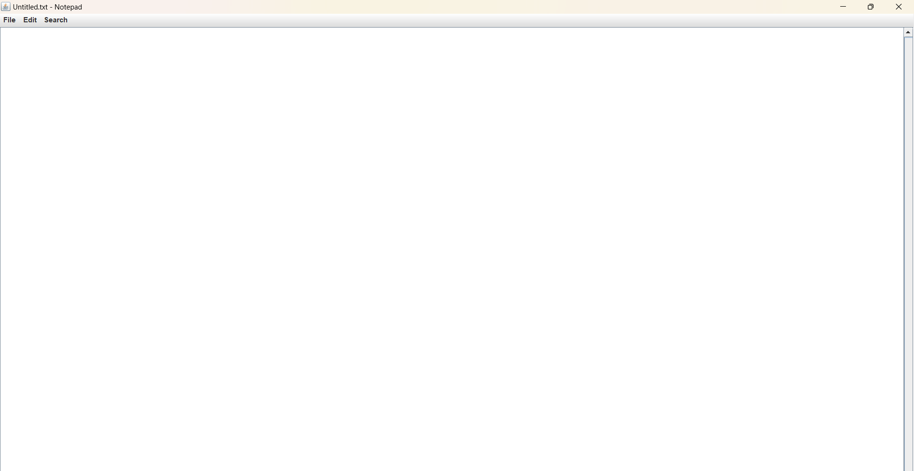
OUTPUT:

Slide 6
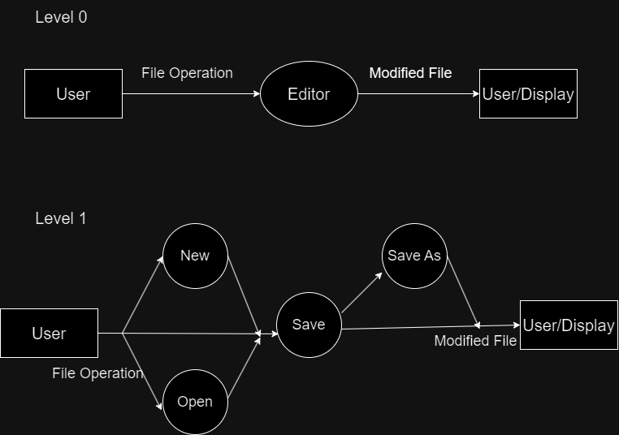
Data Flow Diagram:

Slide 7
Thank you

